Slide 1
MLHS ATHLETICS
MEET THE COACHES NIGHT

Slide 2
ATHLETIC DEPARTMENT CONTACTS
Patrick Brunner– pbrunner@mlschools.org
Office phone: 973-335-4481
Katina Britton– Athletic Assistant - kbritton@mlschools.org
Paul Bongiorno - Athletic Trainer - pbongiorno@mlschools.org
TWITTER @MLHS_Athletics

Slide 3
MLHS ATHLETICS FALL HEAD COACHES
CHEERLEADING | CORINNE PRZYBOROWSKI | cmprzyborowski@outlook.com
CROSS COUNTRY | VICKI ALLISON | vallison@mlschools.org
CROSS COUNTRY | SUSAN BESSIN | sbessin@mlschools.org
FIELD HOCKEY | COLEEN BUCKLEY | cbuckley@mlschools.org
FOOTBALL | DARRELL FUSCO | dfusco@mlschools.org
SOCCER BOYS | MARK WALTERS | mwalters@mlschools.org
SOCCER GIRLS | PATRICK BUTLER | pjbutler@mlschools.org
TENNIS GIRLS | GINNY O'DONNELL | modvlbod@optonline.net
VOLLEYBALL GIRLS | LINDA PETROZELLI | summersoffalways@gmail.com

Slide 4
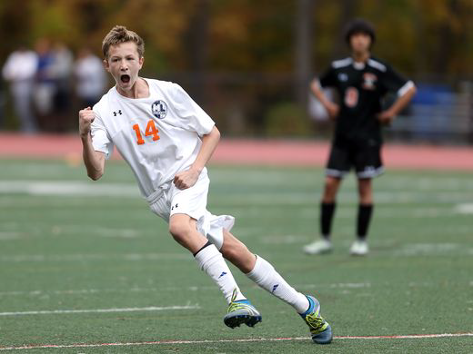
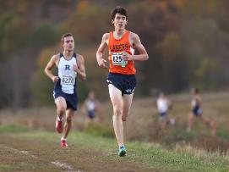
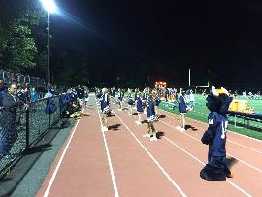
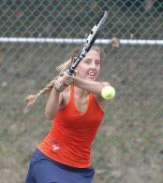
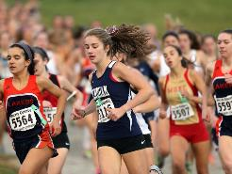
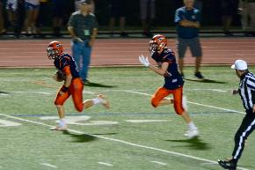
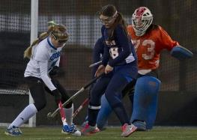
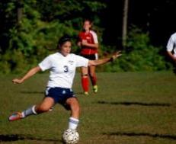
FALL SPORTS

Slide 5
OPENING HOME DATES
Girls Tennis September 4
Girls Soccer September 5
Boys Soccer September 6
Field Hockey September 7
Volleyball September 11
Cross Country September 13
Football September 14

Slide 6
PAPERWORK
FinalForms Initiative
www.mountainlakes-nj.finalforms.com
All forms electronically signed by parent and athlete
Paper copies of Physical and Health History update questionnaire are turned into nurse
When your column is all green you are cleared

Slide 7
Education Based Athletics
Largest classroom in education
Goal is to create a safe, rewarding and competitive athletic experience for all students
Comprehensive training program for our coaches to ensure this experience

Slide 8
COACHES CERTIFICATIONS
All of our coaches are certified in:
Concussion awareness and prevention
Heat acclimatization
First Aid
CPR- AED
Fundamentals of Coaching

Slide 9
TRAINING RULES
A pledge to your team, family and self to avoid…
Alcohol
Drugs
Tobacco products ( including electronic or spit)
Signed by both parents and athletes on FinalForms
…Removal of the team for that season.

Slide 10
HOW TO HANDLE ISSUES
IF THERE IS AN ISSUE –
YOU HAVE THE RIGHT TO COME TALK ABOUT IT USE THE “CHAIN OF COMMAND” 1. ATHLETE TO COACH 2. PARENT AND ATHLETE TO COACH 3. PARENT/ PLAYER TO ATHLETIC DIRECTOR 4. PARENT TO PRINCIPAL/ AD

Slide 11
UPCOMING FALL EVENTS
9/6 - Senior Parent Night 7:30
9/13 - BTSN 7-9 pm
9/14 - Pep Rally
10/1 - Homecoming week begins
10/3 - Bonfire
10/2, 10/4, 10/5 - Evening Athletic Events @ Wilkins Field
10/25 - Talent Show 7:30 auditorium

Slide 12
LAKERS SPORTS CLUB
Lakers Sports Club has given out over $74,000 over the past 3 years. Every sports team has received a grant including Cheer and Weight Room.
Thanks to the generous contributions of the MLHS families, and local businesses, over the last 7 years the Lakers Sports Club was provided $35,000 in scholarships and grants of over $142,000. Additionally, Lakers Sports Club donated $339,000 for the lights at Wilkins Field.
Please take the time to renew your membership tonight or become a member of Lakers Sports Club.

Slide 13
LAKERS SPORTS CLUB
DEFINES WHAT IS GREAT ABOUT THE COMMUNITY AND ITS RELATIONSHIP TO MLHS ATHLETICS
Some recent items purchased thru LSC
Tennis shed
Indoor batting cage
Soccer equipment
Hockey team equipment
Tennis windscreens
Video equipment and services
Soccer goals
MIP plaques – team championship plaques + banners
Baseball field drainage solution
Shooting machine for basketball
Reception for athletes
Ski team radios and jackets
Wrestling banners
Football chute
High jump pit
Golf team range finders

Slide 14
PUBLIC SERVICE ANNOUNCEMENT
PLEASE LEAVE YOUR DOGS AT HOME c/o MLPD AND MLBOE. THIS APPLIES TO ALL CONTESTS AND ALL FIELDS.
ALSO - LEAVE PETS AT HOME FOR AWAY CONTESTS. NJAC CONFERENCE RULE.

